Slide 1
Chapter 18
How to use LINQ

Slide 2
Objectives (part 1)
Applied
Use any of the LINQ features presented in this chapter to query an in-memory data structure such as an array, sorted list, or generic list.
Knowledge
In general terms, explain how LINQ is implemented.
Name the interface that a data source must implement to use LINQ with that data source.
Describe the three stages of a query operation.
Describe how the type of a query variable is determined.
Describe how deferred execution works.
Describe when a query operation results in a projection.
Describe when a query operation results in an anonymous type.

Slide 3
Objectives (part 2)
Describe the purpose of each of the following LINQ clauses: from, where, orderby, select, join.
Explain how extension methods and lambda expressions are used with LINQ.
Compare method-based queries to query expressions.

Slide 4
Some of the C# clauses for working with LINQ
from
where
orderby
select
join

Slide 5
Advantages of using LINQ
Makes it easier for you to query a data source by integrating the query language with C#.
Makes it easier to develop applications that query a data source by providing IntelliSense, compile-time syntax checking, and debugging support.
Makes it easier for you to query different types of data sources because you use the same basic syntax for each type.
Makes it easier for you to use objects to work with relational data sources by providing designer tools that create object-relational mappings.

Slide 6
The three stages of a query operation
Get the data source. If the data source is an array, for example, you must declare the array and then assign values to its elements.
Define the query.
Execute the query to return the results.

Slide 7
A LINQ query that retrieves data from an array
Code that defines the array
int[] numbers = new int[6];
for (int i = 0; i < numbers.Length; i++)
numbers[i] = i;
A statement that defines the query expression
var numberList = from number in numbers
where number % 2 == 0
orderby number descending
select number;
Code that executes the query
string numberDisplay = "";
foreach (var number in numberList)
numberDisplay += number + "\t\t\n";
MessageBox.Show(numberDisplay, "Sorted Even Numbers");

Slide 8
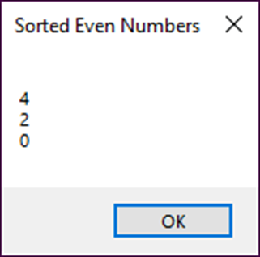
The resulting dialog box

Slide 9
The syntax of the from clause
from [type] elementName in collectionName
An example that uses an array of decimals
A statement that gets the data source
decimal[] salesTotals =
new decimal[4] {1286.45m, 2433.49m, 2893.85m,
2094.53m};
A statement that defines the query expression
var salesList = from sales in salesTotals
select sales;
Code that executes the query
decimal sum = 0;
foreach (var sales in salesList)
sum += sales;

Slide 10
An example that uses a generic list of invoices as the data source (part 1)
The Invoice class
public class Invoice
{
public int InvoiceID { get; set; }
public int CustomerID { get; set; }
public DateTime InvoiceDate { get; set; }
public decimal ProductTotal { get; set; }
public decimal SalesTax { get; set; }
public decimal Shipping { get; set; }
public decimal InvoiceTotal { get; set; }
}
A statement that gets the data source
List<Invoice> invoiceList = InvoiceDB.GetInvoices();

Slide 11
An example that uses a generic list of invoices as the data source (part 2)
A statement that defines the query expression
var invoices = from invoice in invoiceList
select invoice;
Code that executes the query
decimal sum = 0;
foreach (var invoice in invoices)
sum += invoice.InvoiceTotal;

Slide 12
The syntax of the where clause
where condition
An example that filters the salesTotals array
A query expression that returns only sales greater than $2000
var salesList = from sales in salesTotals
where sales > 2000
select sales;
Code that executes the query
string salesDisplay = "";
foreach (var sales in salesList)
salesDisplay += sales.ToString("c") + "\t\t\n";
MessageBox.Show(salesDisplay, "Sales Over $2000");

Slide 13
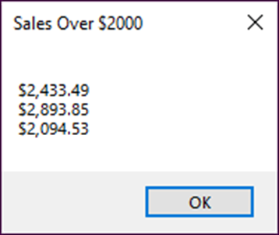
The dialog box with filtered sales totals

Slide 14
An example that filters the generic list of invoices
A query expression that returns invoices with totals over $150
var invoices = from invoice in invoiceList
where invoice.InvoiceTotal > 150
select invoice;
Code that executes the query
string invoiceDisplay = "";
foreach (var invoice in invoices)
invoiceDisplay +=
invoice.InvoiceTotal.ToString("c") + "\t\t\n";
MessageBox.Show(invoiceDisplay, "Invoices Over $150");

Slide 15
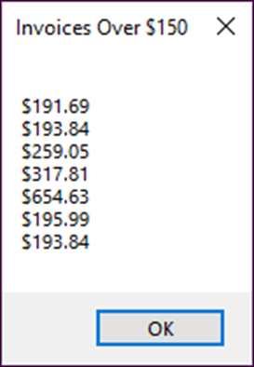
The dialog box with filtered invoices

Slide 16
The syntax of the orderby clause
orderby expression1 [ascending|descending]
[, expression2 [ascending|descending]]...
An example that sorts the salesTotals array
A query expression that sorts the sales in ascending sequence
var salesList = from sales in salesTotals
where sales > 2000
orderby sales
select sales;
Code that executes the query
string salesDisplay = "";
foreach (var sales in salesList)
salesDisplay += sales.ToString("c") + "\t\t\t\n";
MessageBox.Show(salesDisplay, "Sorted Sales Over $2000");

Slide 17
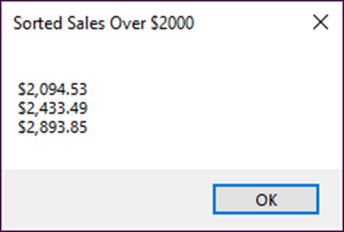
The dialog box with sorted sales totals

Slide 18
An example that sorts the generic list of invoices
A query expression that sorts the invoices by customer ID and invoice total
var invoices = from invoice in invoiceList
where invoice.InvoiceTotal > 150
orderby invoice.CustomerID,
invoice.InvoiceTotal descending
select invoice;
Code that executes the query
string invoiceDisplay = "Cust ID\tInvoice amount\n";
foreach (var invoice in invoices)
invoiceDisplay += invoice.CustomerID + "\t"
+ invoice.InvoiceTotal.ToString("c")
+ "\n";
MessageBox.Show(invoiceDisplay,
"Sorted Invoices Over $150");

Slide 19
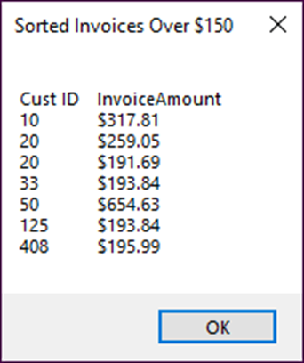
The dialog box with sorted invoices

Slide 20
Two ways to code the select clause
select columnExpression
select new [type] { [PropertyName1 =] columnExpression1
[, [PropertyName2 =] columnExpression2]... }

Slide 21
An example that selects key values from a sorted list
The employee sales sorted list
SortedList<string, decimal> employeeSales = new SortedList<string, decimal>
{ ["Anderson"] = 1286.45m, ["Menendez"] = 2433.49m,
["Thompson"] = 2893.85m, ["Wilkinson"] = 2094.53m };
A query expression that selects the employee names
var employeeList = from sales in employeeSales
where sales.Value > 2000
orderby sales.Value descending
select sales.Key;
Code that executes the query
string employeeDisplay = "";
foreach (var employee in employeeList)
employeeDisplay += employee + "\t\t\t\n";
MessageBox.Show(employeeDisplay,
"Sorted Employees With Sales Over $2000");

Slide 22
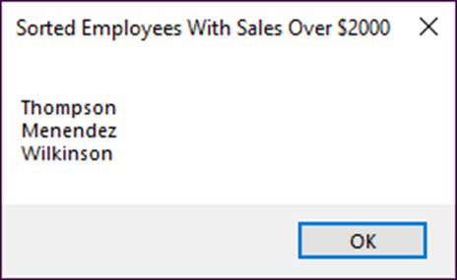
The dialog box with selected employees

Slide 23
A query expression that creates an anonymous type from the list of invoices
var invoices = from invoice in invoiceList
where invoice.InvoiceTotal > 150
orderby invoice.CustomerID,
invoice.InvoiceTotal descending
select new { invoice.CustomerID,
invoice.InvoiceTotal };

Slide 24
The basic syntax of the join clause
join elementName in collectionName on keyName1 equals keyName2
An example that joins data from two generic lists
The Customer class
public class Customer
{
public int CustomerID { get; set; }
public string Name { get; set; }
}
Code that gets the two data sources
List<Invoice> invoiceList = InvoiceDB.GetInvoices();
List<Customer> customerList = CustomerDB.GetCustomers();

Slide 25
A query expression that joins data from the two data sources
var invoices = from invoice in invoiceList
join customer in customerList
on invoice.CustomerID equals customer.CustomerID
where invoice.InvoiceTotal > 150
orderby customer.Name, invoice.InvoiceTotal descending
select new { customer.Name, invoice.InvoiceTotal };

Slide 26
Code that executes the query
string invoiceDisplay = "Customer Name\t\tInvoice amount\n";
foreach (var invoice in invoices)
{
invoiceDisplay += invoice.Name + "\t\t";
invoiceDisplay += invoice.InvoiceTotal.ToString("c") + "\n";
}
MessageBox.Show(invoiceDisplay, "Joined Customer and Invoice Data");

Slide 27
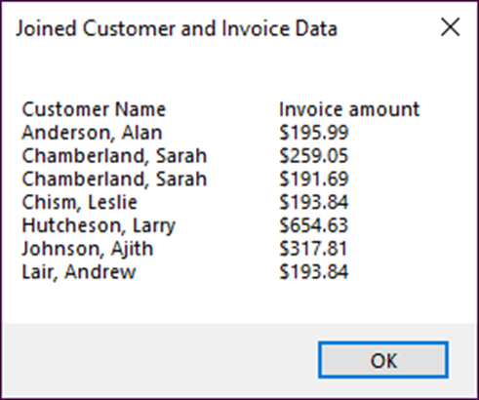
The dialog box with joined data

Slide 28
An extension method that extends the String data type
A class with an extension method that formats a phone number
public static class StringExtensions
{
public static string FormattedPhoneNumber(this string phone,
string separator)
{
return phone.Substring(0, 3) + separator
+ phone.Substring(3, 3) + separator
+ phone.Substring(6, 4);
}
}
Code that uses the extension method
string phoneNumber = "5595551212";
string formattedPhoneNumber =
phoneNumber.FormattedPhoneNumber(".");
MessageBox.Show(formattedPhoneNumber + "\t", "Extension Method");

Slide 29
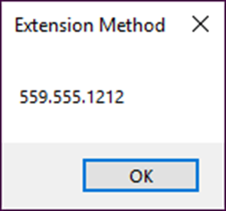
The dialog box with a formatted phone number

Slide 30
The basic syntax of a lambda expression
[(]parameterList[)] => expression
A lambda expression that tests a condition
Declare the delegate type at the class level
delegate bool compareDel(decimal total);
Define the lambda expression and assign it to a variable created from the delegate type
compareDel invoiceOver150 = total => total > 150;
Execute the lambda expression
decimal invoiceTotal = 188.46m;
string invoiceMessage = "";
invoiceMessage += "Invoice Total: " + invoiceTotal.ToString("c") + "\n" + "Invoice over $150: " +
invoiceOver150(invoiceTotal);
MessageBox.Show(invoiceMessage, "Invoice Test");

Slide 31
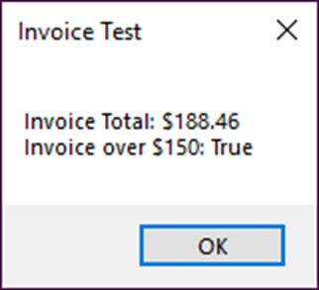
The dialog box with the result of a lambda expression

Slide 32
Extension methods used to implement common C# clauses for LINQ
Clause Method
where Where()
orderby OrderBy(), OrderByDescending(), ThenBy(), ThenByDescending()
select Select()
join Join()

Slide 33
A method-based query that filters and sorts the results and selects fields
var invoices = invoiceList
.Where(i => i.InvoiceTotal > 150)
.OrderBy(i => i.CustomerID)
.ThenByDescending(i => i.InvoiceTotal)
.Select(i => new { i.CustomerID, i.InvoiceTotal });

Slide 34
A method-based query that joins data from two data sources
var invoices = invoiceList.Join(customerList, i => i.CustomerID, c => c.CustomerID, (i, c) => new { c.Name, i.InvoiceTotal }) .Where(ci => ci.InvoiceTotal > 150) .OrderBy(ci => ci.Name) .ThenByDescending(ci => ci.InvoiceTotal);

Slide 35
A method-based query that joins data and selects fields
var invoices = invoiceList.Join(customerList, i => i.CustomerID, c => c.CustomerID, (i, c) => new { c.Name, i.InvoiceDate,
i.InvoiceTotal }) .Where(ci => ci.InvoiceTotal > 150) .OrderBy(ci => ci.Name) .ThenBy(ci => ci.InvoiceDate)
.Select(ci => new { ci.Name, ci.InvoiceTotal });

Slide 36
Additional LINQ methods (part 1)
Method Description
Count() Gets the number of elements in the results of a query.
Average() Calculates the average of an expression in the results of a query.
Sum() Calculates the sum of an expression in the results of a query.
Max() Gets the maximum value of an expression in the results of a query.
Min() Gets the minimum value of an expression in the results of a query.

Slide 37
Additional LINQ methods (part 2)
Method Description
First() Gets the first element from the results of a query.
FirstOrDefault() Gets the first element from the results of a query or a default value if no element exists.
Single() Gets the only element from the results of a query. Throws an exception if the results don’t contain exactly one element.
SingleOrDefault() Gets the only element from the results of a query or a default value if no element exists. Throws an exception if the results contain more than one element.

Slide 38
Additional LINQ methods (part 3)
Method Description
Skip() Skips over the specified number of elements in the results of a query and then returns the remaining elements.
Take() Gets the specified number of elements from the beginning of the results of a query.
ToList() Creates a List<T> object from the results of a query.

Slide 39
A query that gets a count of the items in the results
int invoiceCount = invoiceList
.Where(i => i.InvoiceTotal > 150)
.Count();
A query that gets the invoice total for the items in the results
decimal invoiceTotal = invoiceList
.Where(i => i.InvoiceDate >= DateTime.Parse("01/01/2020")
& i.InvoiceDate <= DateTime.Parse("06/30/2020"))
.Sum(i => i.InvoiceTotal);

Slide 40
A query that gets a subset of the results
int skipCount = 20;
int takeCount = 10;
var invoices = invoiceList
.Skip(skipCount)
.Take(takeCount);

Slide 41
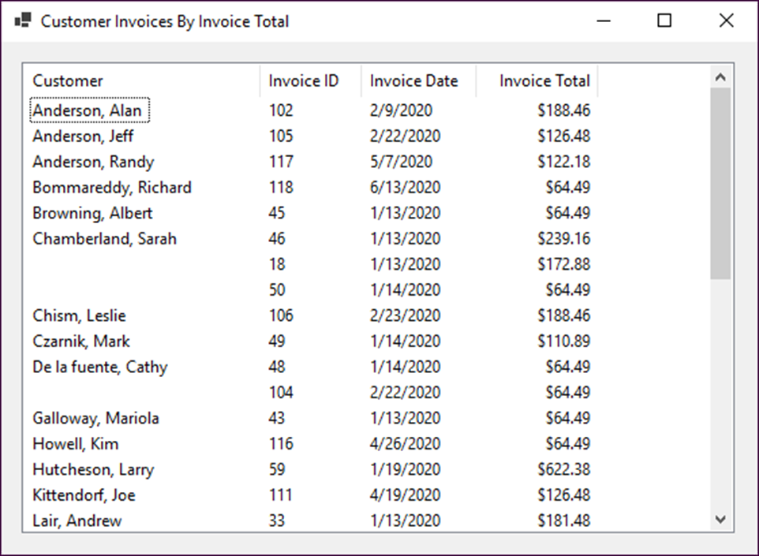
The Customer Invoice form

Slide 42
The code for the Customer Invoice form (part 1)
private void Form1_Load(object sender, EventArgs e)
{
List<Customer> customerList =
CustomerDB.GetCustomers();
List<Invoice> invoiceList = InvoiceDB.GetInvoices();
var invoices = from invoice in invoiceList
join customer in customerList
on invoice.CustomerID
equals customer.CustomerID
orderby customer.Name,
invoice.InvoiceTotal descending
select new { customer.Name,
invoice.InvoiceID,
invoice.InvoiceDate,
invoice.InvoiceTotal };
string customerName = "";
int i = 0;

Slide 43
The code for the Customer Invoice form (part 2)
foreach (var invoice in invoices)
{
if (invoice.Name != customerName)
{
lvInvoices.Items.Add(invoice.Name);
customerName = invoice.Name;
}
else
{
lvInvoices.Items.Add("");
}
lvInvoices.Items[i].SubItems.Add( invoice.InvoiceID.ToString());
lvInvoices.Items[i].SubItems.Add(
Convert.ToDateTime(
invoice.InvoiceDate).ToShortDateString());
lvInvoices.Items[i].SubItems.Add(
invoice.InvoiceTotal.ToString("c"));
i += 1;
}
}

Slide 44
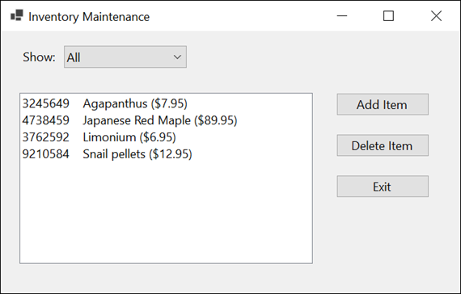
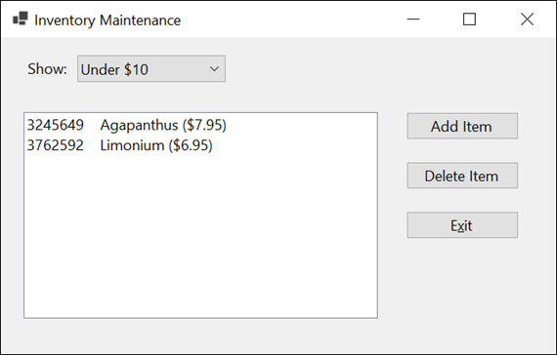
Extra 18-1 Use LINQ
Use LINQ to update the Inventory Maintenance application of extra exercise 17-2.

Slide 45
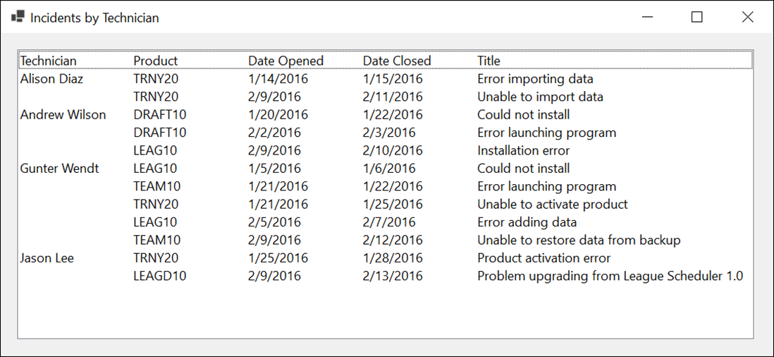
Project 4-3 Display incidents by technician
Use LINQ to join the data in two List<> objects and then display that data in a ListView control.

Slide 46
Objectives (part 1)
Applied
Use any of the LINQ features presented in this chapter to query an in-memory data structure such as an array, sorted list, or generic list.
Knowledge
In general terms, explain how LINQ is implemented.
Name the interface that a data source must implement to use LINQ with that data source.
Describe the three stages of a query operation.
Describe how the type of a query variable is determined.
Describe how deferred execution works.
Describe when a query operation results in a projection.
Describe when a query operation results in an anonymous type.

Slide 47
Objectives (part 2)
Describe the purpose of each of the following LINQ clauses: from, where, orderby, select, join.
Explain how extension methods and lambda expressions are used with LINQ.
Compare method-based queries to query expressions.

